Slide 1
An XML-based schema for stochastic programs
H.I. Gassmann, R. Fourer, J. Ma, R.K. Martin
EURO XXI, June 2006, Reykjavik

Slide 2
Outline
Motivation and review
Dynamic and stochastic structure
A four-stage investment problem
Instance representations
OSiL format
Conclusions and future work

Slide 3
Why a standard?
Benchmarking
Archiving
Algorithm development
Distributed computing
Sharing of problem instances

Slide 4
Why XML?
Easy to accommodate new features
Existing parsers to check syntax
Easy to generate automatically
Trade-off between verbosity and human readability
Arbitrary precision and name space
Stochastic extensions for dynamic and stochastic structure

Slide 5
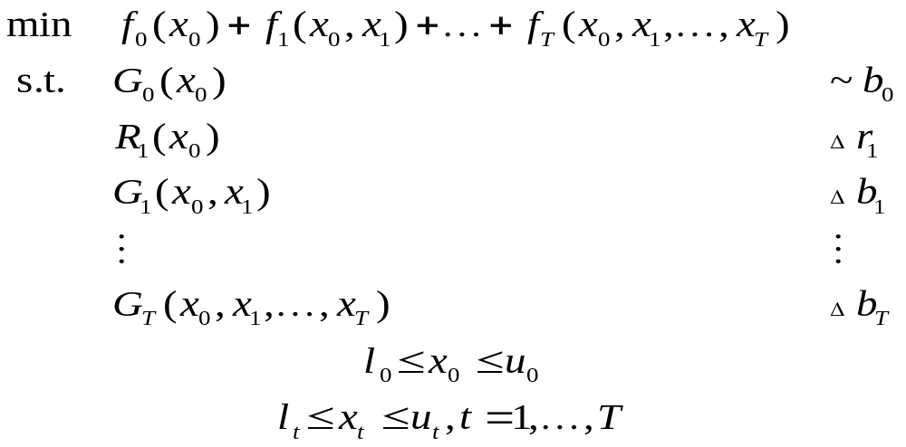
Stochastic programs
“ ”
Any data item with nonzero subscript may be random
(including dimensions where mathematically sensible)
~ stands for arbitrary relation (≤, =, ≥)

Slide 6
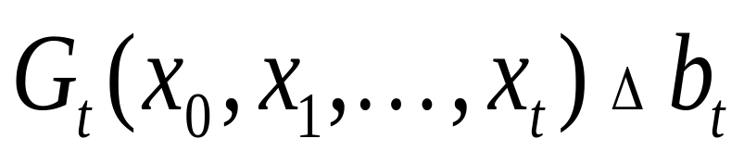
Constraints involving random elements
Δ means ~ with probability 1
or with probability at least β
or with expected violation at most v
or …
Notes:
Probability 1: Deterministic constraint or almost surely
Probability β: Probabilistic constraint (VaR)
Expected violation: CVaR

Slide 7
Problem classes
Recourse problems
  All constraints hold with probability 1
Chance-constrained problems
  Typically single stage
Hybrid problems
  Recourse problems including features such as chance constraints or integrated chance constraints
Distribution problems
  Determine distribution of optimum objective and/or decisions

Slide 8
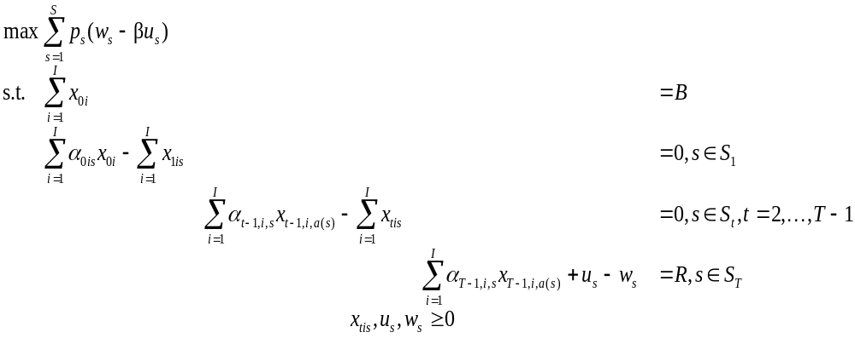
Example (Birge)
S₀
S₁
S₂
I = 2, T = 3, B = 55, R = 80,
α_{t1} = {1.25, 1.06},
α_{t2} = {1.14, 1.12}
…

Slide 9
Dynamic and stochastic structure
Dynamic structure
  Periods/stages
Stochastic structure
  Nonanticipativity
  Independent random variables
  Period-to-period independence
  Scenario tree
  Factor models
  ARMA processes
  Trap states and stochastic problem dimensions

Slide 10
What is an instance?
Role and number of constraints, objectives, parameters and variables must be known
Every parameter’s value(s) must be known
Continuous entities vs. discretization
  Decision variables
  Objective and constraints
  Distribution of random variables
  Time domain

Slide 11
Instance representation
Internal representations
SMPS format
  Limited precision
  Limited to linear problems
Algebraic modelling languages
  Discrete distributions only
  Limited consistency checks
OSiL format

Slide 12
What is a stage?
Stages form a subset of the time structure
Stages comprise both decisions and events
Events must either precede all decisions or follow all decisions
Should a stage be decision – event or event – decision?

Slide 13
Why is there a problem?
AMPL-like declarations:
set time ordered;
param demand{t in time} random;
Production_balance {t in time}:
Inv[t-1] + product[t] >= demand[t] + Inv[t];
Is the constraint well-posed?
At least two possible interpretations
  Inv[t] set after demand[t] known: recourse form, well-posed
  Inv[t] set before demand[t] known: undeclared chance constraint

Slide 14
SMPS format
Three files based on MPS format
  Core file for deterministic problem components
  Time file for dynamic structure
  Stoch file for stochastic structure
Disadvantages
  Old technology
  Limited precision (12 digits, including sign)
  Limited name space (8 characters)
  Direction of optimization (min/max) ambiguous
  Linear constraints, quadratic objective only

Slide 15
Example (SMPS)
I = 2, T = 3, B = 55, R = 80, α_{t1} = {1.25, 1.06}, α_{t2} = {1.14, 1.12}
Core file
ROWS
Budget0
Object
Budget1
Budget2
Budget3
COLS
X01 Budget0 1.0
X01 Budget1 1.25
...
RHS
rhs1 Budget0 55.
rhs1 Budget3 80.
ENDATA
Stoch file
BLOCKS DISCRETE
BL Block1 0.5
X01 Budget1 1.25
X02 Budget1 1.14
BL Block1 0.5
X01 Budget1 1.06
X02 Budget1 1.12
BL Block2 0.5
X11 Budget2 1.25
X12 Budget2 1.14
...
ENDATA

Slide 16
Algebraic modelling languages
Characteristics
  Similar to algebraic notation
  Powerful indexing capability
  Data verification possible
Disadvantages
  Discrete distributions only
  Limited consistency checks for stochastic structure

Slide 17
AMPL model
param T;
param penalty;
param budget;
param target;
set instruments;
set scenarios;
param prob{scenarios};
set slice{t in 0..T} within scenarios;
param ancestor {t in 1..T, s in slice[t]};
var over {slice[T]};
var under{slice[T]};
param return {t in 1..T, i in instruments,s in slice[t]};
var invest {t in 0..T-1,i in instruments,s in slice[t]};
maximize net_profit:
sum{s in scenarios} prob[s]*(over[s] - penalty*under[s]);
subject to wealth{t in 0..T, s in slice[t]}:
(if t < T then sum{i in instruments} invest[t,i,s]) =
(if t = 0 then budget
else sum {i in instruments}
return[t,i,s]*invest[t-1,i,ancestor[t,s]]
+ if t = T then under[s] - over[s] + target);

Slide 18
OSiL Schema
Written in XML
Very flexible
Intended to handle as many types of mathematical programs as possible
  Linear and integer
  Nonlinear
  Stochastic
  …

Slide 19
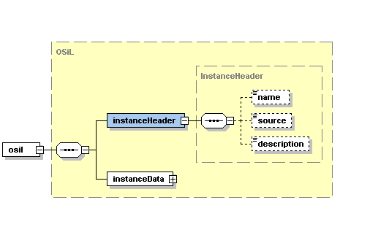
OSiL Schema – Header information

Slide 20
Header information – Example
<?xmlversion="1.0"encoding="UTF8"?>
<osil xmlns="os.optimizationservices.org“
xmlns:xsi=http://www.w3.org/2001/XMLSchemainstance
xsi:schemaLocation="OSiL.xsd">
<instanceHeader>
<name>FinancialPlan_JohnBirge</name>
<source>
Birge and Louveaux, Stochastic Programming
</source>
<description>
Three-stage stochastic investment problem
</description>
</instanceHeader >
<instanceData>
...
</instanceData>
</osil>

Slide 21
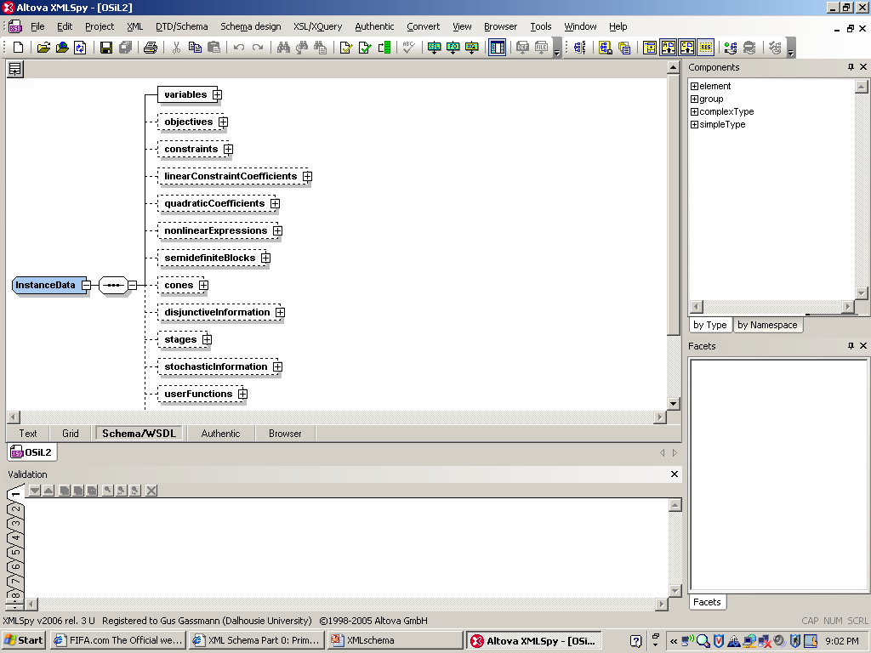
OSiL Schema – Deterministic data
…

Slide 22
Instance data –
Constraints, objectives, variables
<variables numberOfVariables="8">
<var name="invest01" type="C" lb="0.0"/>
<var name="invest02"/>
<var name="invest11"/>
<var name="invest12"/>
<var name="invest21"/>
<var name="invest22"/>
<var name="w"/>
<var name="u"/>
</variables>
<objectives numberOfObjectives="1">
<obj maxOrMin="max" numberOfObjCoef= "2" lb="0.0">
<coef idx="6"/>1.</coef>
<coef idx="7"/>-4.</coef>
</obj>
</objectives>
<constraints numberOfConstraints="4">
<con name="budget0" lb="55" ub="55"/>
<con name="budget1" lb="0" ub="0"/>
<con name="budget2" lb="0" ub="0"/>
<con name="budget3" lb="80" ub="80"/>
</constraints>

Slide 23
Instance data –
Core matrix (sparse matrix form)
<linearConstraintCoefficients
numberOfValues=“14">
<start>
<el>0</el>
<el>2</el>
<el>4</el>
<el>6</el>
<el>8</el>
<el>10</el>
<el>12</el>
<el>13</el>
<el>14</el>
</start>
<rowIdx>
<el>0</el>
<el>1</el>
<el>0</el>
<el>1</el>
<el>1</el>
<el>2</el>
<el>1</el>
<el>2</el>
<el>2</el>
<el>3</el>
<el>2</el>
<el>3</el>
<el>3</el>
<el>3</el>
</rowIdx>
<value>
<el>1</el>
<el>1.25</el>
<el>1</el>
<el>1.14</el>
<el>1</el>
<el>1.25</el>
<el>1</el>
<el>1.14</el>
<el>1</el>
<el>1.25</el>
<el>1</el>
<el>1.14</el>
<el>1</el>
<el>-1</el>
</value>

Slide 24
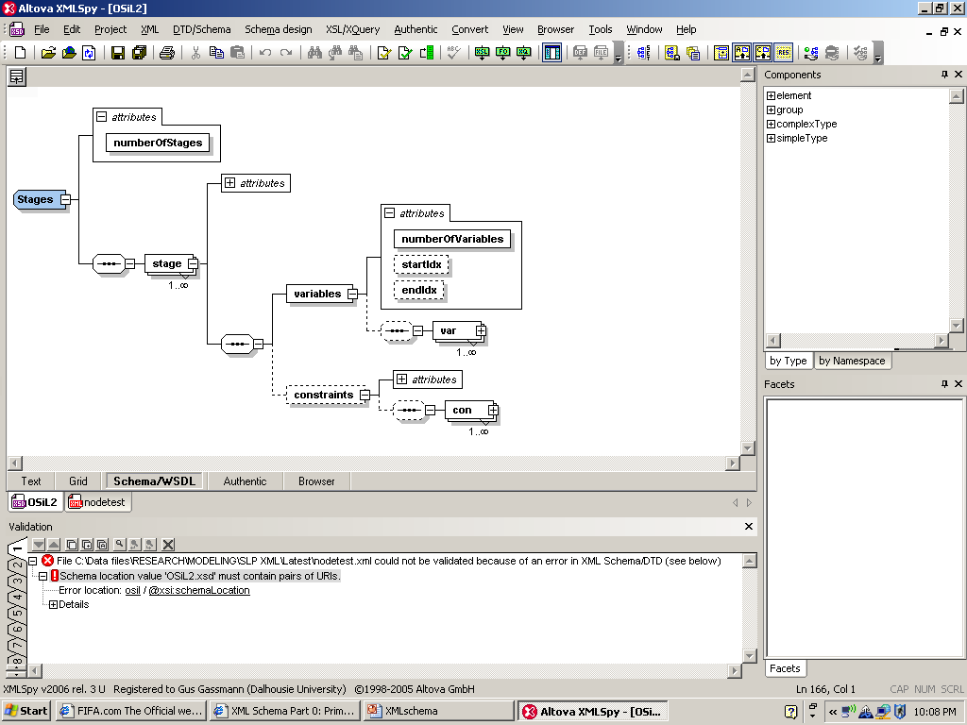
OSiL Schema – Dynamic structure

Slide 25
Dynamic information – Example
<stages numberOfStages="4">
<stage>
<variables numberOfVariables="2" startIdx="0" endIdx="1"/>
<constraints numberOfConstraints="1" startIdx="0"/>
</stage>
<stage>
<variables numberOfVariables="2" startIdx="2" endIdx="3"/>
<constraints numberOfConstraints="1" startIdx="1"/>
</stage>
<stage>
<variables numberOfVariables="2" startIdx="4" endIdx="5"/>
<constraints numberOfConstraints="1" startIdx="2"/>
</stage>
<stage>
<variables numberOfVariables="2">
<var idx="6"> <var idx="7">
</variables>
<constraints numberOfConstraints="1" startIdx="3"/>
</stage>
</stages>

Slide 26
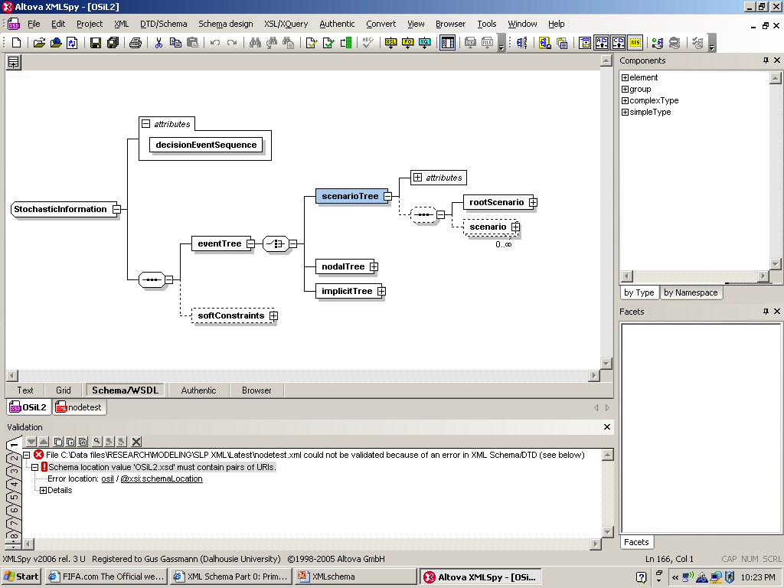
Explicit and implicit event trees

Slide 27
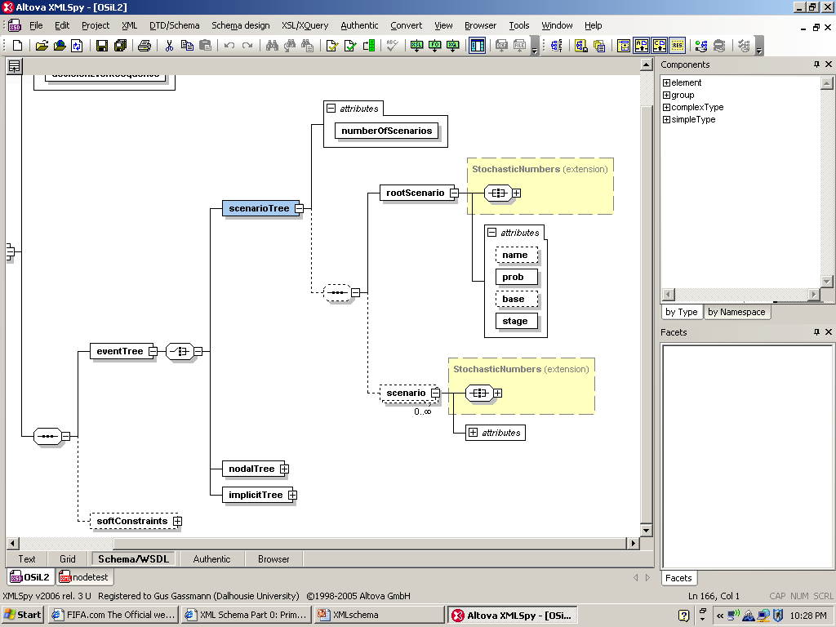
Scenario trees

Slide 28
Scenario tree – Example
<stochasticInformation decisionEvenSequence="DecisionAfterEvent">
<eventTree>
<scenarioTree numberOfScenarios="8">
<rootScenario prob="1" stage="0"/>
<scenario prob="0.5" stage="3" parent="0">
<linearConstraintCoefficients>
<el rowIdx="3" colIdx="4">1.06</el>
<el rowIdx="3" colIdx="5">1.12</el>
</linearConstraintCoefficients>
</scenario>
<scenario prob="0.5" stage="2" parent="0">
…

Slide 29
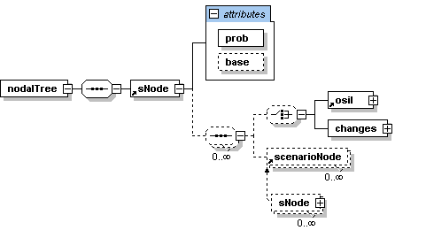
Node-by-node representation for stochastic problem dimensions

Slide 30
Node-by-node – Example
<stochasticInformation decisionEvenSequence="DecisionAfterEvent">
<eventTree >
<nodalTree>
<sNode prob="1" base="coreProgram">
<sNode prob="0.5" base="coreProgram">
<sNode prob="0.5" base="coreProgram">
<sNode prob="0.5" base="coreProgram"/>
<sNode prob="0.5" base="firstSibling">
<changes>
<el rowIdx=“3" colIdx="4">1.06</el>
<el rowIdx="3" colIdx="5">1.12</el>
</changes>
</sNode>
</sNode>
…

Slide 31
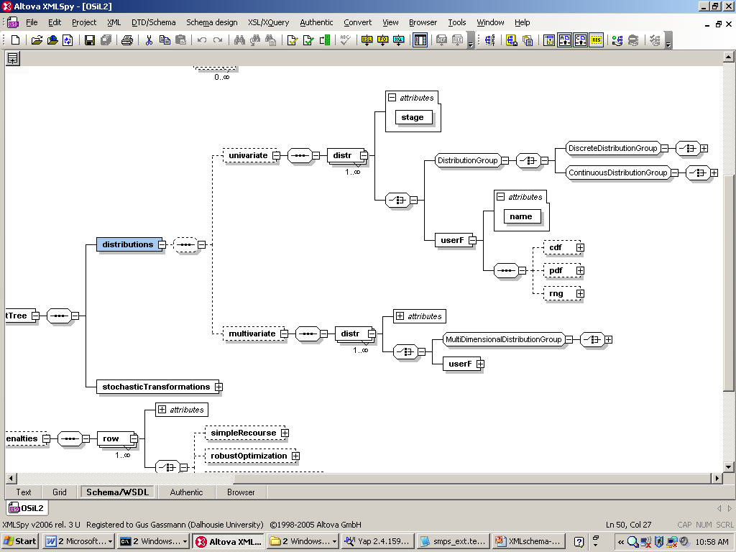
Distributions (implicit tree)

Slide 32
Discrete random vector
<distributions>
<multivariate>
<distr stage="1">
<multiDimensionalDistributionGroup>
<multivariateDiscrete>
<scenario>
<prob>0.5</prob>
<el>1.25</el>
<el>1.14</el>
</scenario>
<scenario>
<prob>0.5</prob>
<el>1.06</el>
<el>1.12</el>
</scenario>
</multivariateDiscrete>
</multiDimensionalDistributionGroup>
</distr>
…
</multivariate>
</distributions>

Slide 33
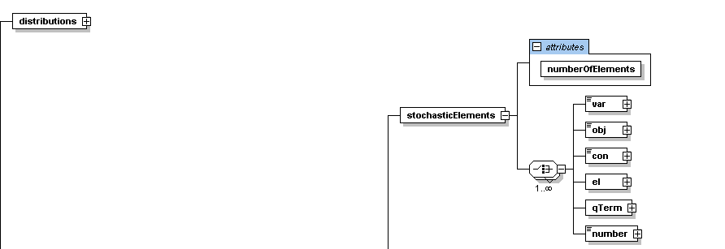
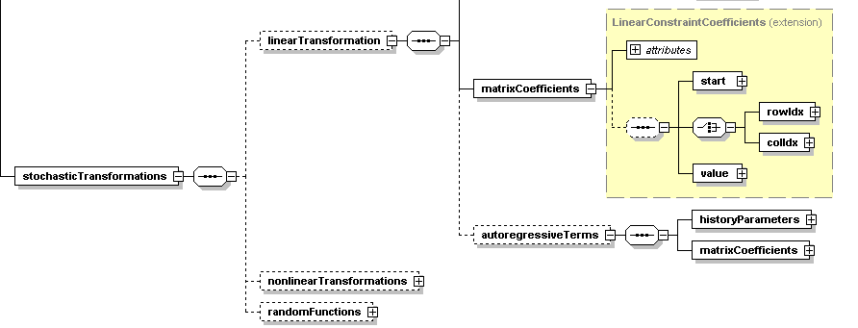
Transformations – p = f(v)

Slide 34
Linear transformation – Example
<stochasticTransformation>
<linearTransformation>
<stochasticElements
numberOfElements="6">
<el rowIdx="1" colIdx="0"/>
<el rowIdx="1" colIdx="1"/>
<el rowIdx="2" colIdx="2"/>
<el rowIdx="2" colIdx="3"/>
<el rowIdx="3" colIdx="4"/>
<el rowIdx="3" colIdx="5"/>
</stochasticElements>
<matrixCoefficients
numberOfElements="6">
<start>
<el>0</el>
<el>1</el>
<el>2</el>
<el>3</el>
<el>4</el>
<el>5</el>
<el>6</el>
</start>
<rowIdx>
<el>0</el>
<el>1</el>
<el>2</el>
<el>3</el>
<el>4</el>
<el>1</el>
</rowIdx>
<value>
<el mult=“6">1.0</el>
</value>
</matrixCoefficients>
</linearTransformation>
</stochasticTransformation>

Slide 35
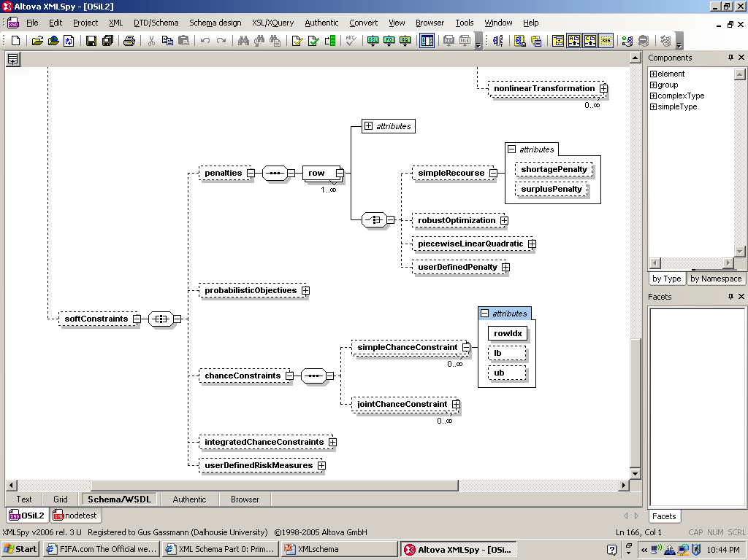
Penalties and probabilistic constraints

Slide 36
Capabilities
Arbitrary nonlinear expressions
Arbitrary distributions
Scenario trees
Stochastic problem dimensions
Simple recourse
Soft constraints with arbitrary penalties
Probabilistic constraints
Arbitrary moment constraints

Slide 37
Nonlinear expression –
(x₀ – x₁²)² + (1 – x₀)²
<plus>
<power>
<minus>
<var coef="1.0" idx="0"/>
<power>
<var coef="1.0" idx="1"/>
<number value="2"/>
</power>
</minus>
<number value="2"/>
</power>
<power>
<minus>
<number value="1"/>
<var coef="1.0" idx="0"/>
</minus>
<number value="2"/>
</power>
</plus>

Slide 38
Further work
Readers
Internal data structures
Solver interfaces
Library of problems
Buy-in

Slide 39

QUESTIONS?
http://www.optimizationservices.org
http://myweb.dal.ca/gassmann

